Slide 1
VOLTAGE CONTROLLED OSCILLATOR
In this project we are to design a voltage controlled oscillator running at 1kHz for a set target voltage of 1.

Slide 2
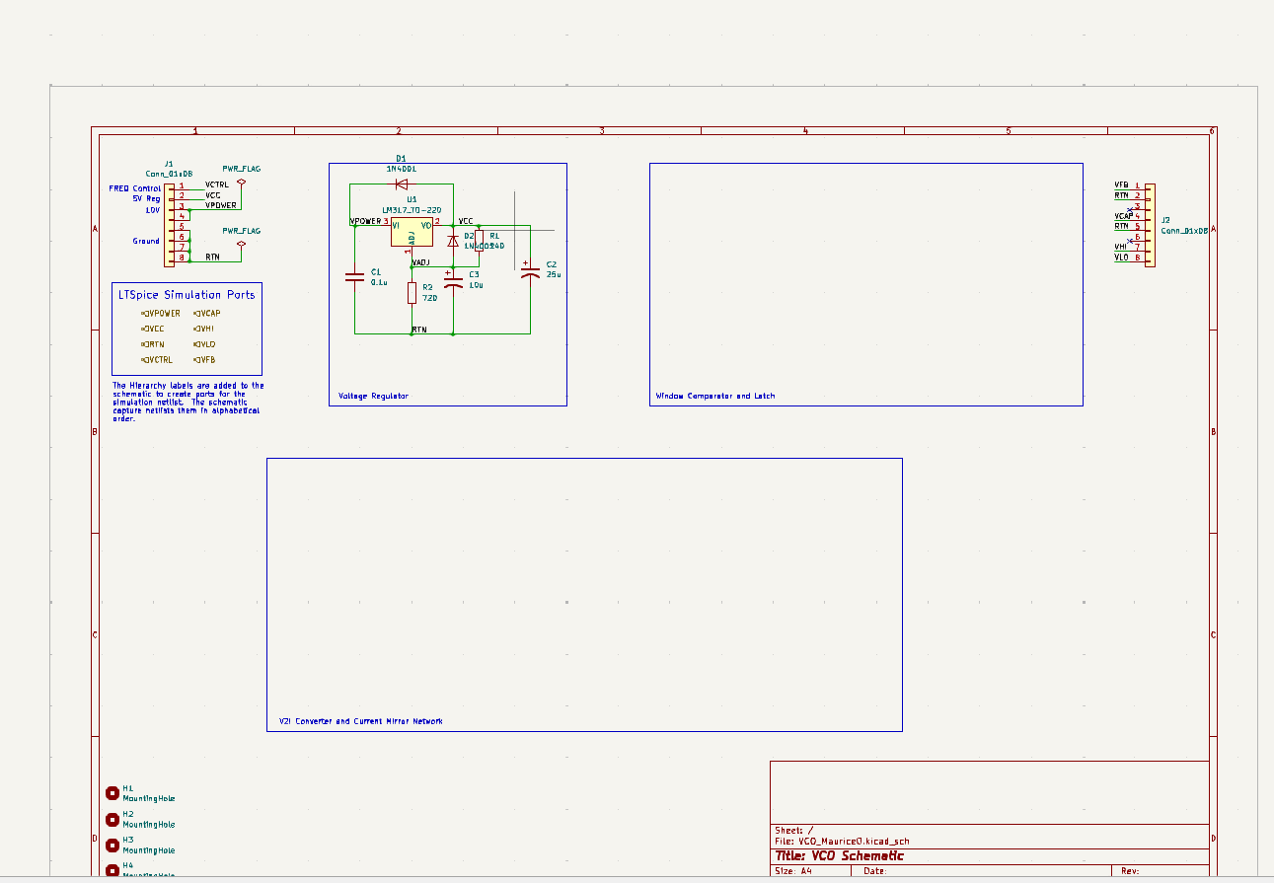
The voltage regulator

Slide 3
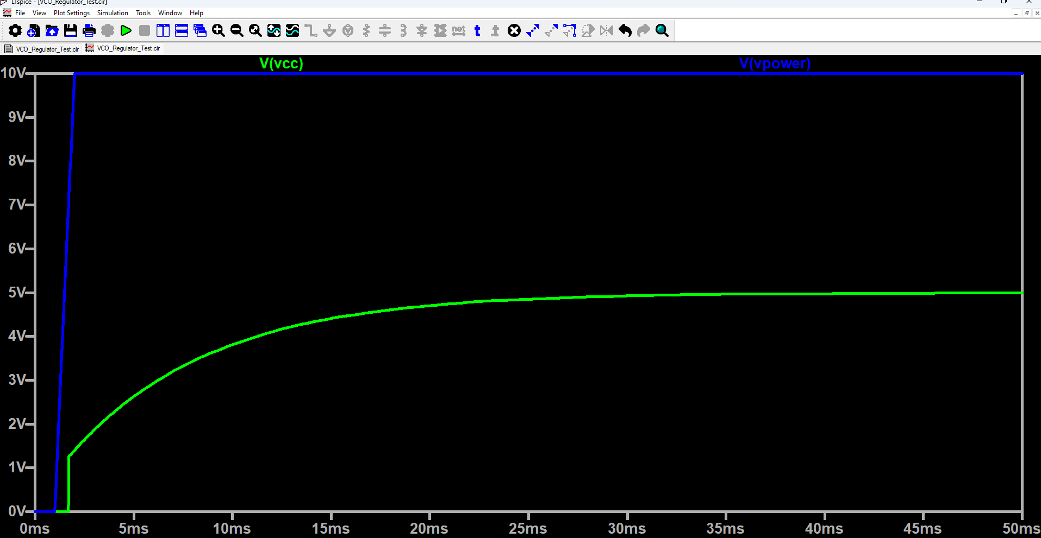
Voltage regulation unit

Slide 4
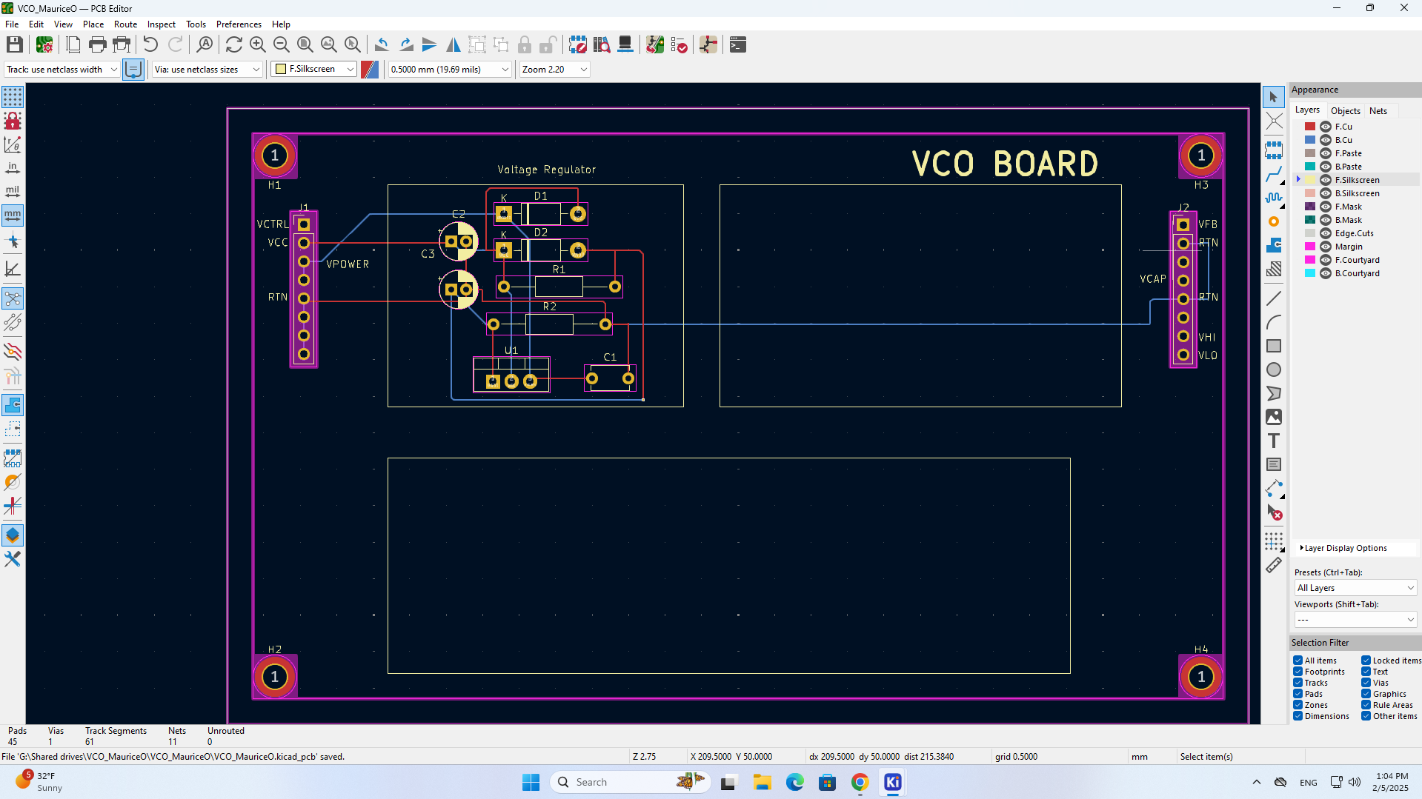

Slide 5
Current mirror s
In this lab we added the current mirror circuit that pushes current to and pulls current from the capacitor to charge and discharge it into our schematic. We ran a nested dc sweep of vctrl, vcap and vfb checking that the current sits at the required 0.1mA set by the voltage to current converter circuit.

Slide 6
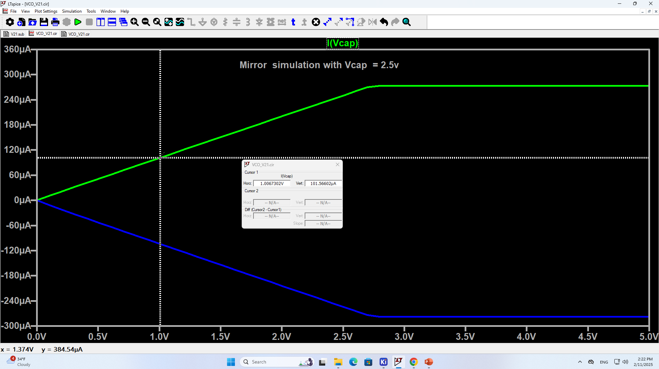

Slide 7
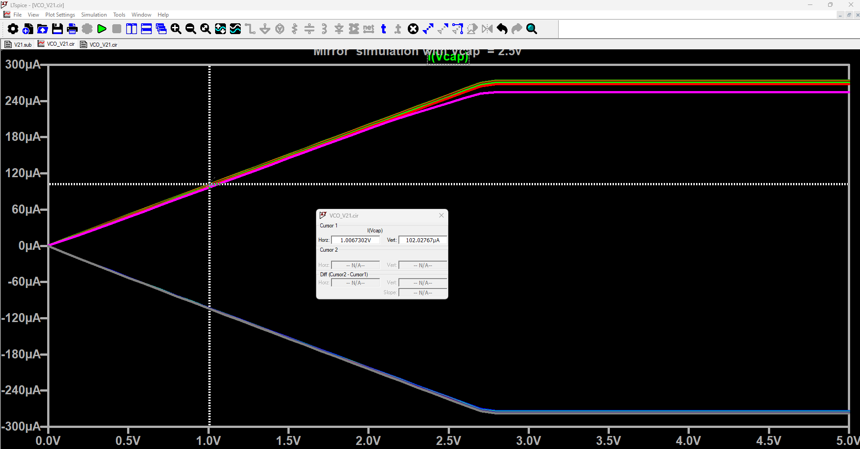

Slide 8
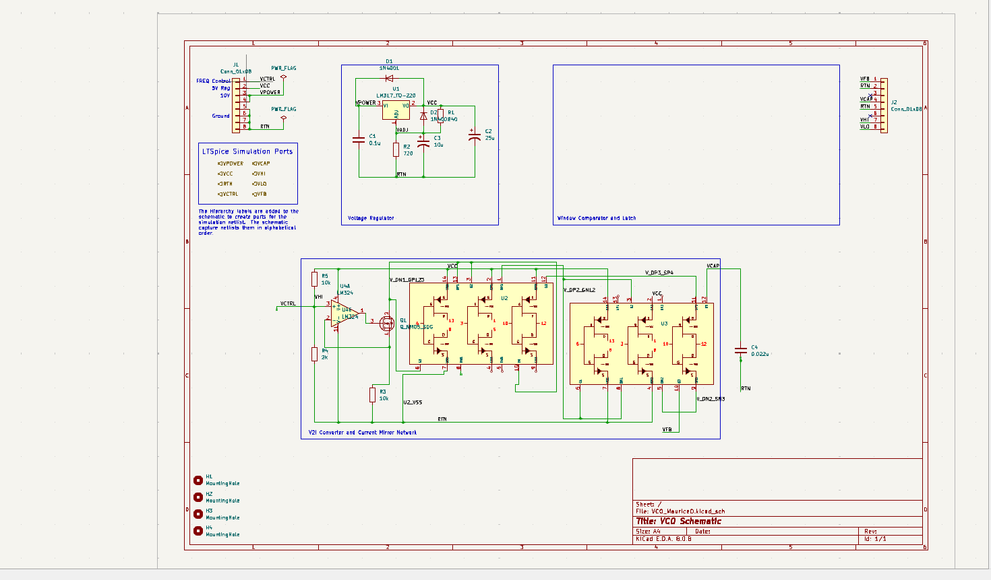
Circuit schematic with current mirrors

Slide 9
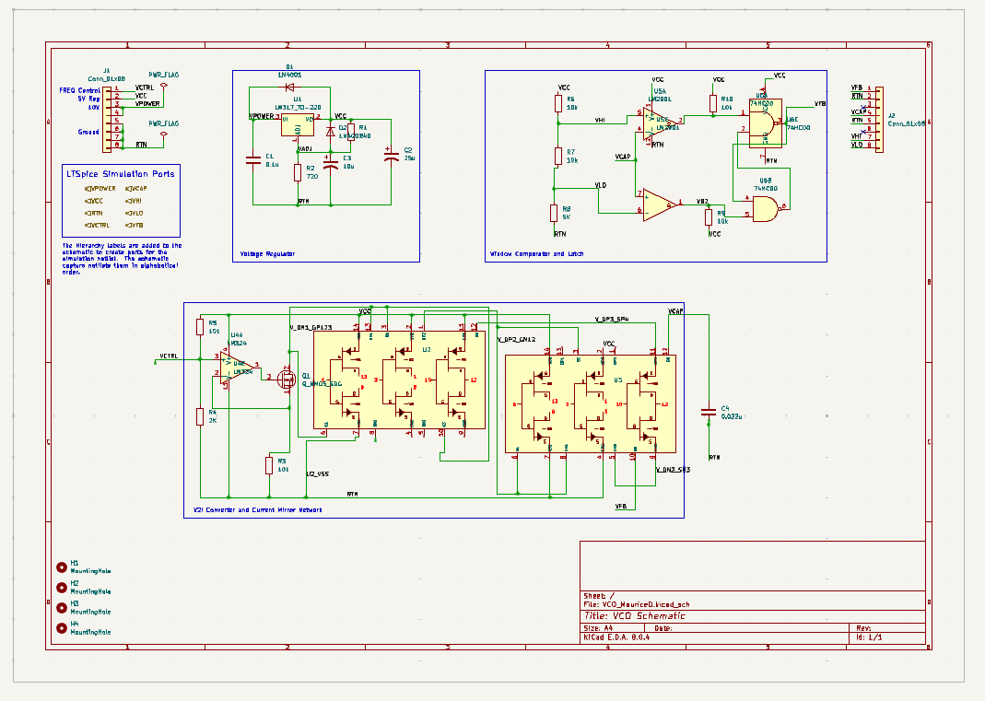
Full VCO schematic

Slide 10
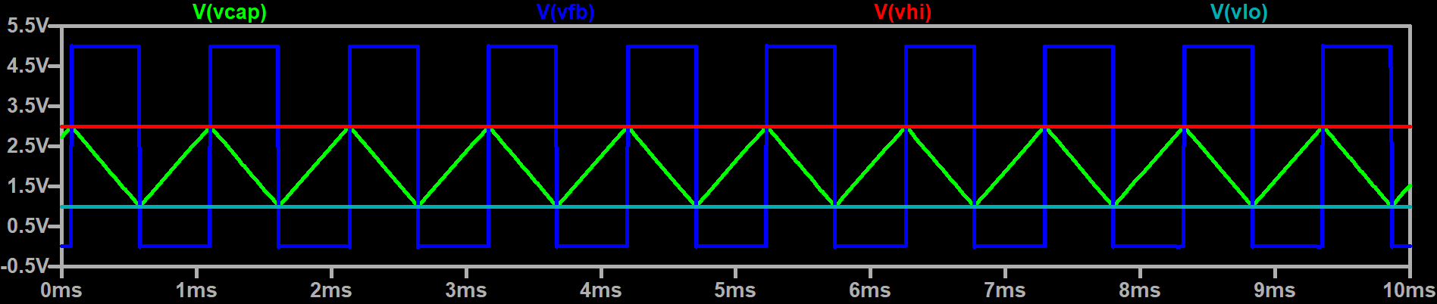
Full VCO simulation

Slide 11
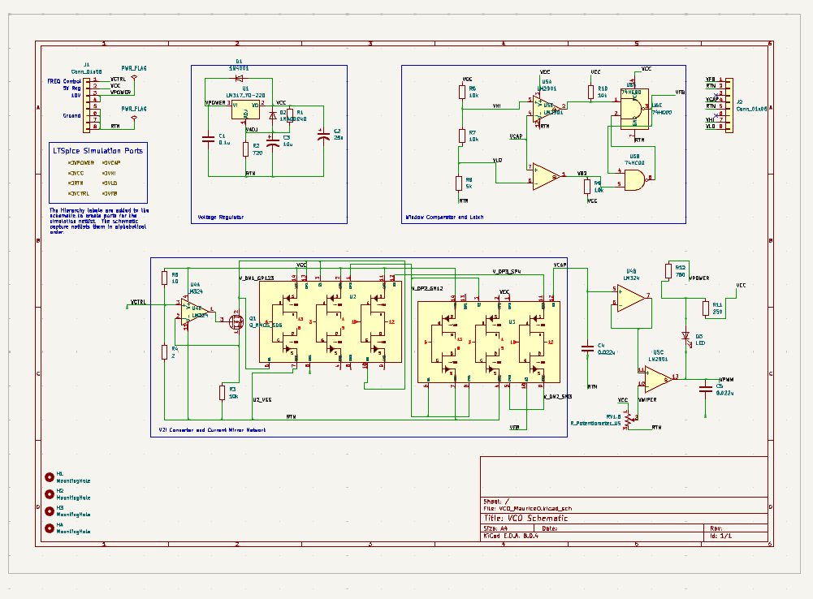
VCO with PWM unit

Slide 12
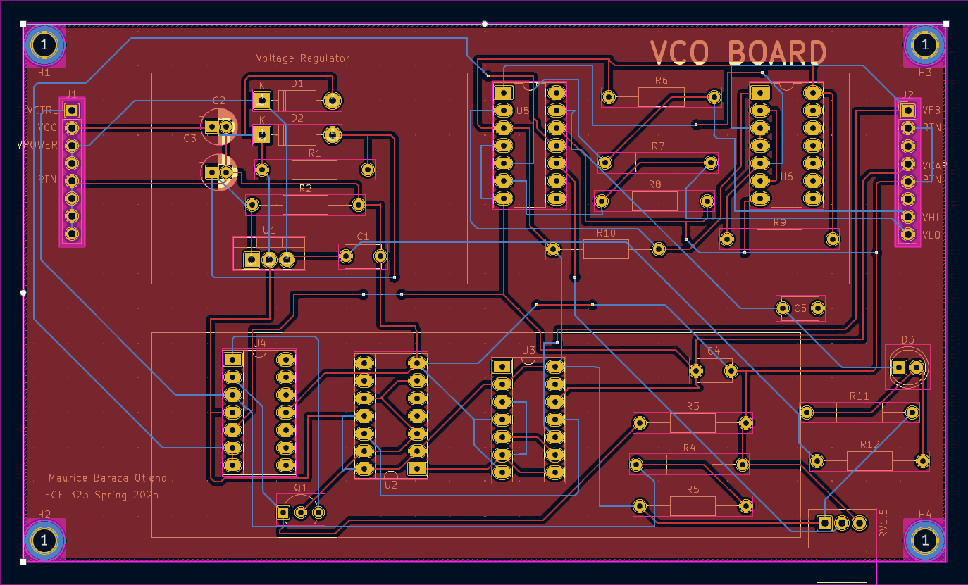

Slide 13
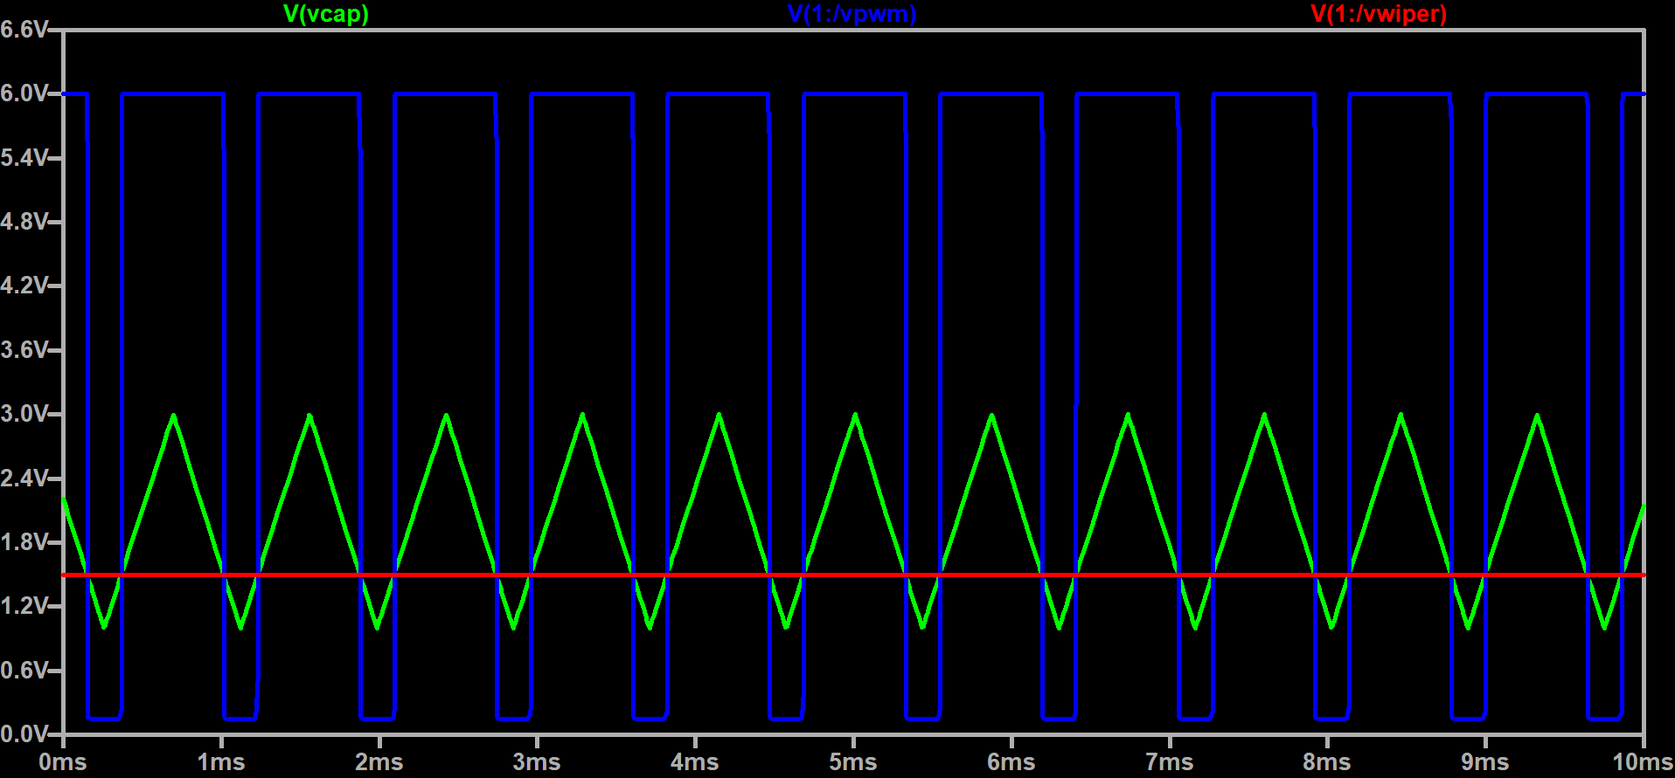
VCAP,VPWM ,VWIPER Waveforms

Slide 14
Final build and characterization
We are to run different tests on our board assembly. The final PCB with all the components soldered in looks somewhat like the figure below.

Slide 15
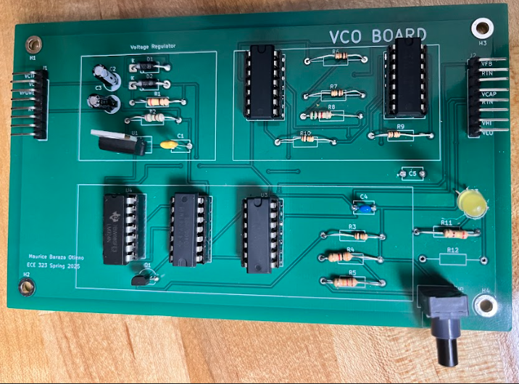

Slide 16
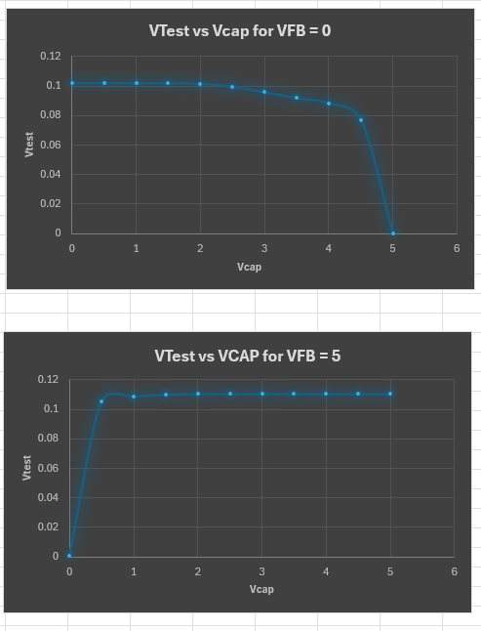
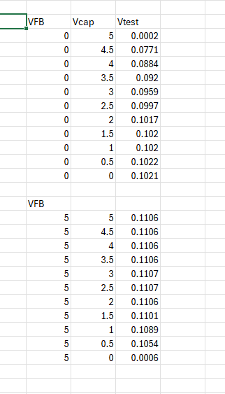

Slide 18
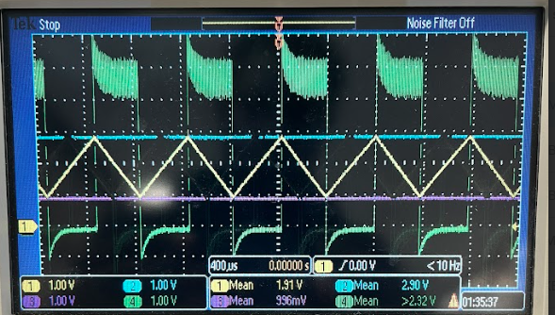

Slide 19
